Slide 1






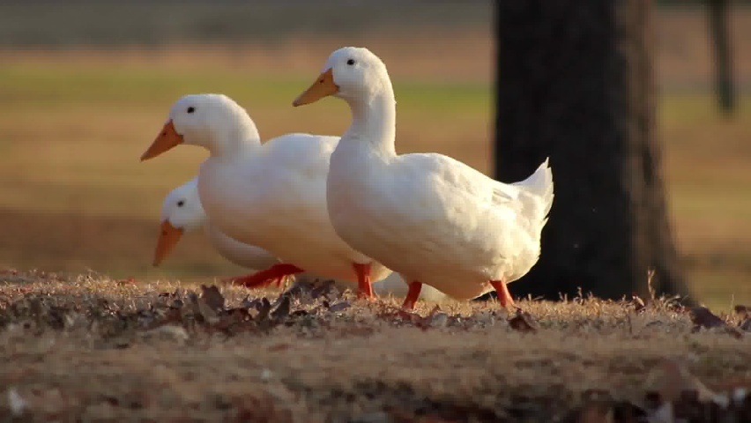
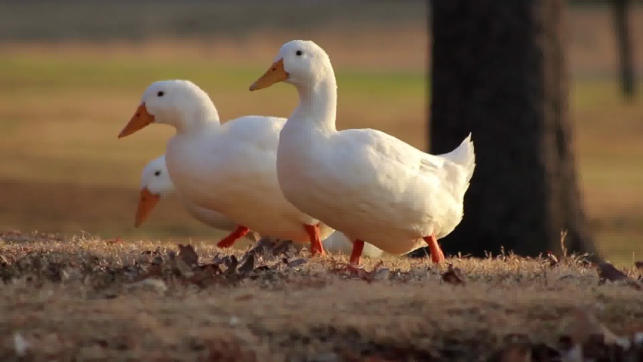
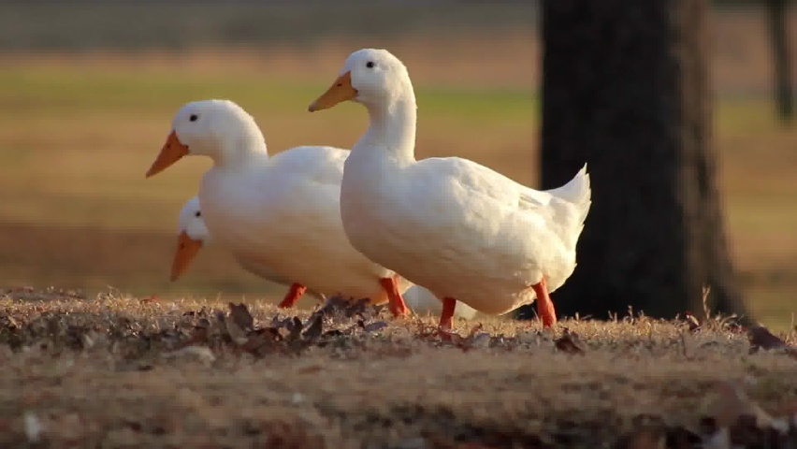
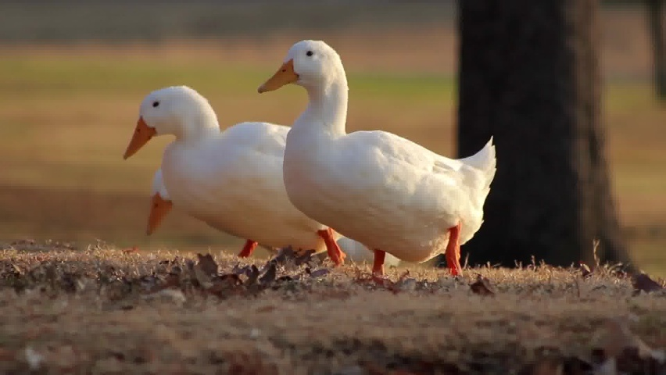
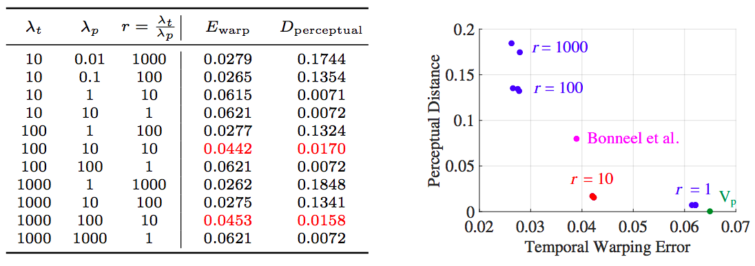
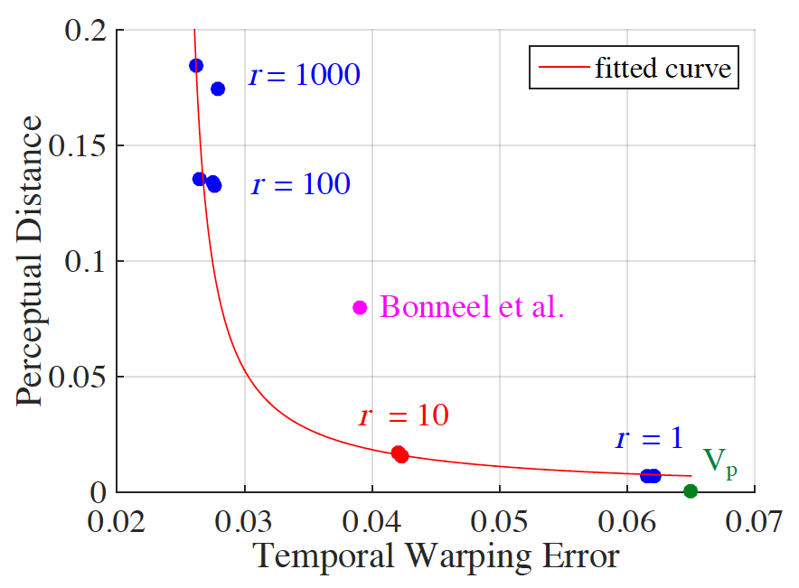
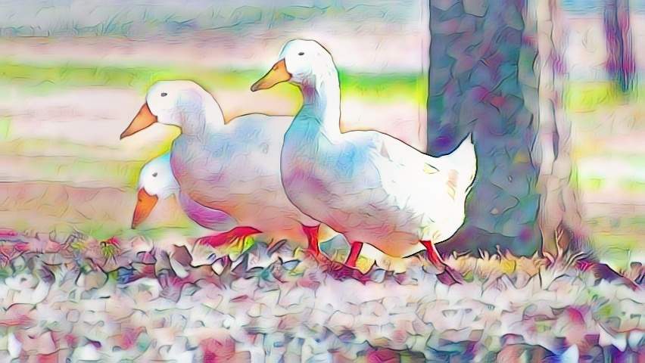

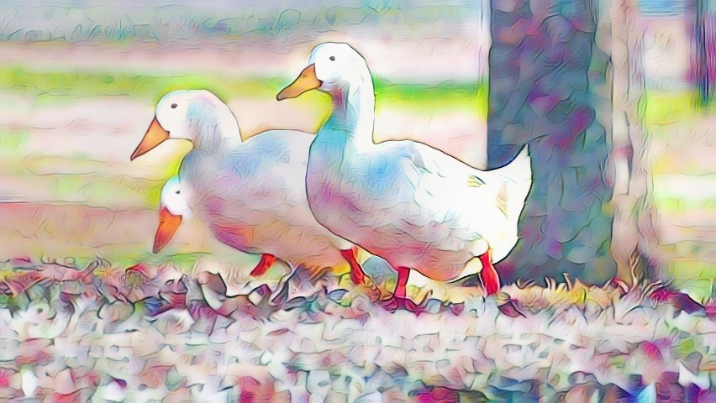

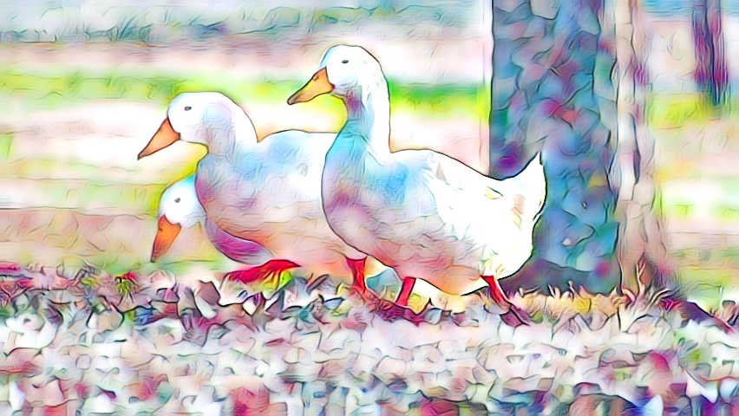
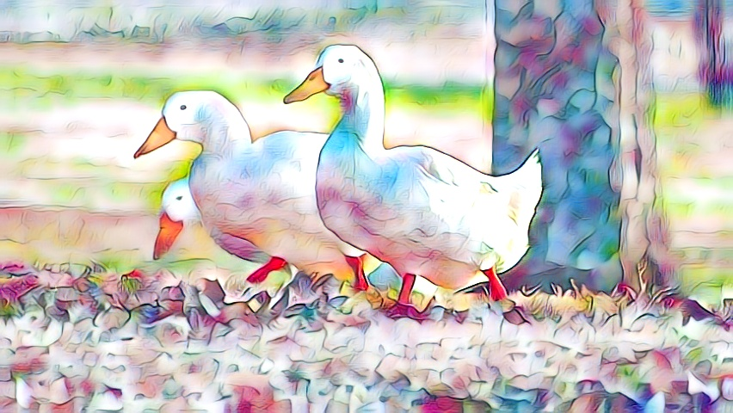
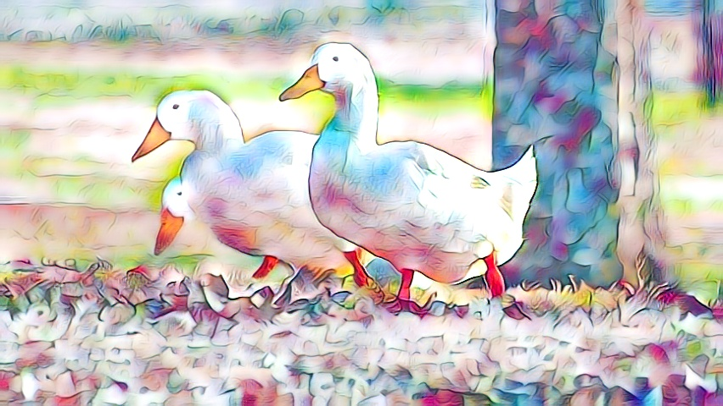
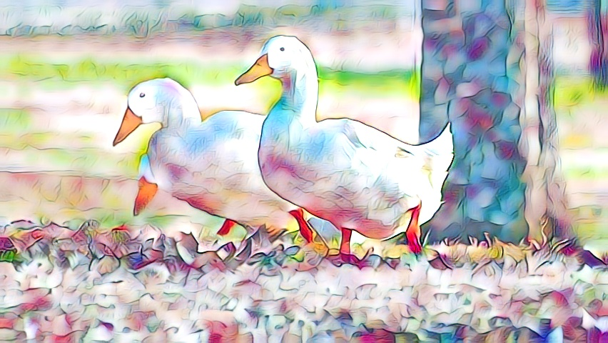
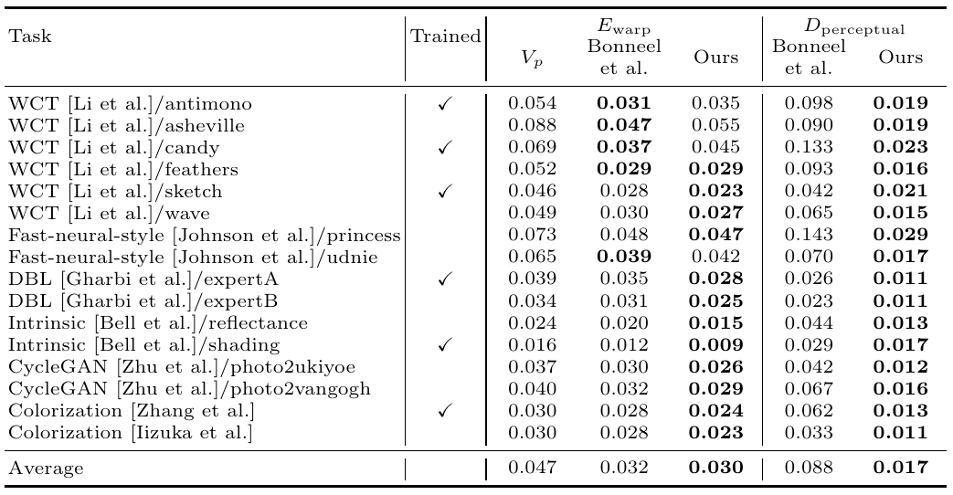
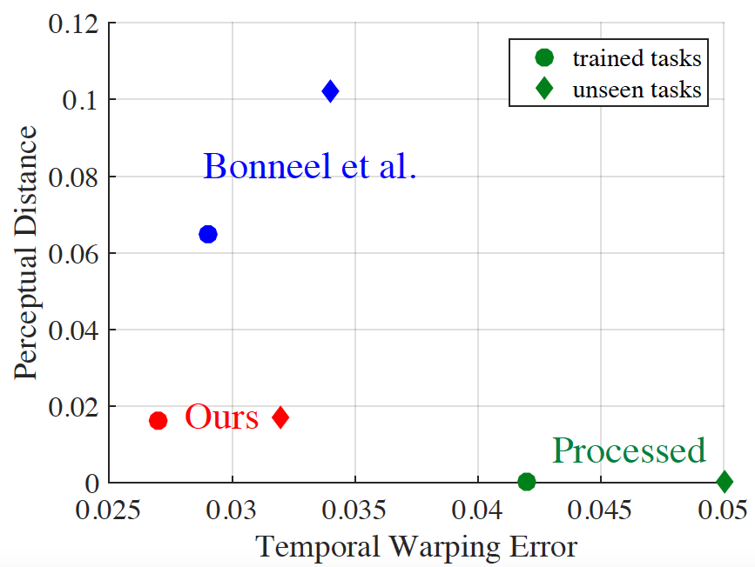
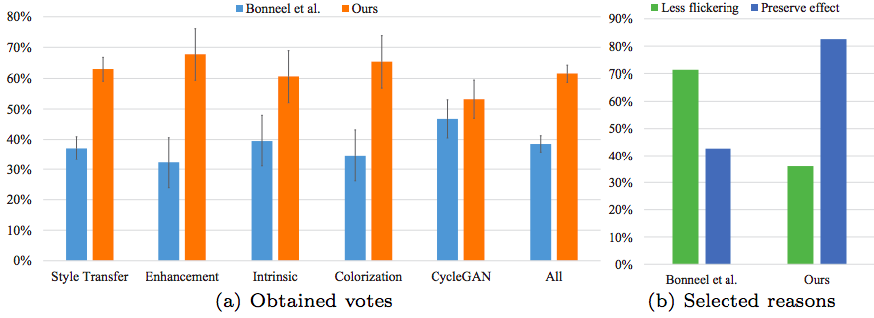
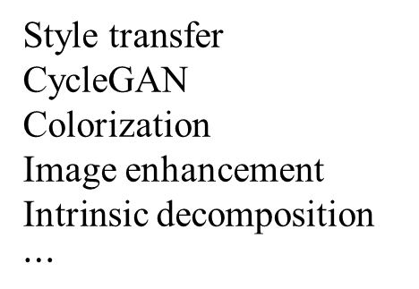
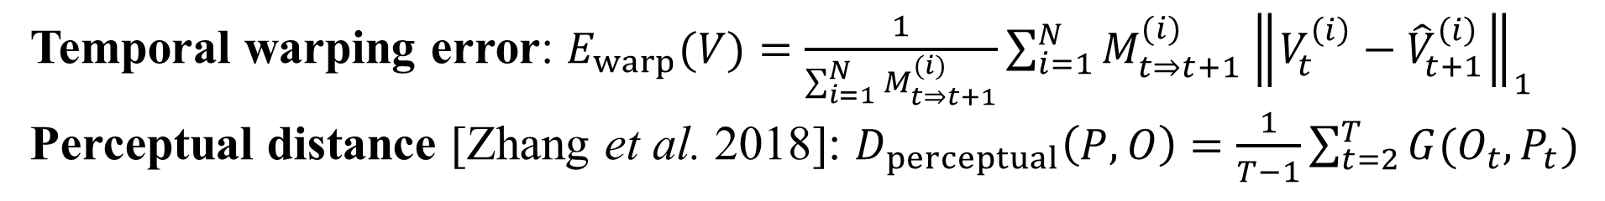
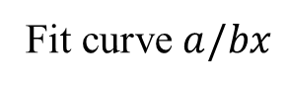
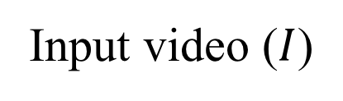
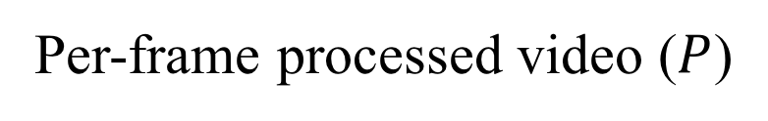
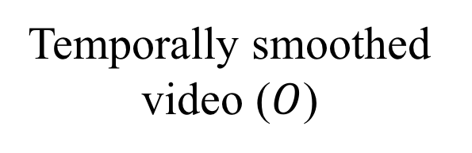
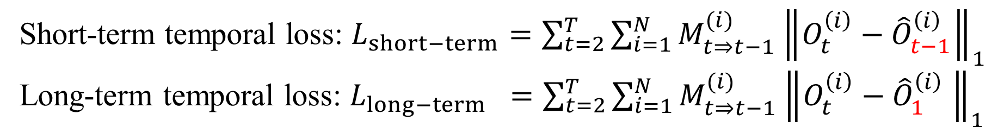
Learning Blind Video Temporal Consistency
Code and data available at http://bit.ly/VideoConsistency
Wei-Sheng Lai¹ Jia-Bin Huang² Oliver Wang³ Eli Shechtman³ Ersin Yumer⁴ Ming-Hsuan Yang^{1,5}
¹University of California, Merced ²Virginia Tech ³Adobe Research ⁴Argo AI ⁵Google Cloud AI
Problem Setup
Network Architecture
Experimental Results
Input video ($I$)
Temporal warping error: $E_{warp}(V)=\frac{1}{\sum_{i=1}^{N}{M_{t⇒t+1}^{(i)}}}\sum_{i=1}^{N}{M_{t⇒t+1}^{(i)}{\left\|V_{t}^{\left(i\right)}−{\hat{V}}_{t+1}^{\left(i\right)}\right\|}_{1}}$
Perceptual distance [Zhang et al. 2018]: $D_{perceptual}\left(P, O\right)=\frac{1}{T−1}\sum_{t=2}^{T}{G(O_{t}, P_{t})}$
Optical flow
Occlusion mask
Analysis
Image-based Algorithm
Style transfer
CycleGAN
Colorization
Image enhancement
Intrinsic decomposition
$$⋯$$
Our method
Fit curve $a/bx$
Temporally smoothed video ($O$)
Testing
Per-frame processed video ($P$)
Quantitative evaluation
Existing Work
Training Loss
Task-specific methods require domain knowledge to design specific algorithms for individual tasks
Task-independent methods assume specific filter formulation [Lang et al. 2012] or fail to preserve processing effect [Bonneel et al. 2015]
Short-term temporal loss: $L_{short−term}=\sum_{t=2}^{T}{\sum_{i=1}^{N}{M_{t⇒t−1}^{(i)}{\left\|O_{t}^{\left(i\right)}−{\hat{O}}_{t−1}^{\left(i\right)}\right\|}_{1}}}$
Long-term temporal loss: $L_{long−term} =\sum_{t=2}^{T}{\sum_{i=1}^{N}{M_{t⇒t−1}^{(i)}{\left\|O_{t}^{\left(i\right)}−{\hat{O}}_{1}^{\left(i\right)} \right\|}_{1}}}$
Contributions
Data-driven: learns a recurrent network to reduce temporal flickering in videos
Balanced: maintains temporal stability and perceptual similarity
Fast: runs at 400+ FPS (on Titan X GPU). Does not require optical flow or frame correspondences at test time
Application-agnostic: handles multiple and unseen applications with a single model
User study
Notes:
author

